Slide 1
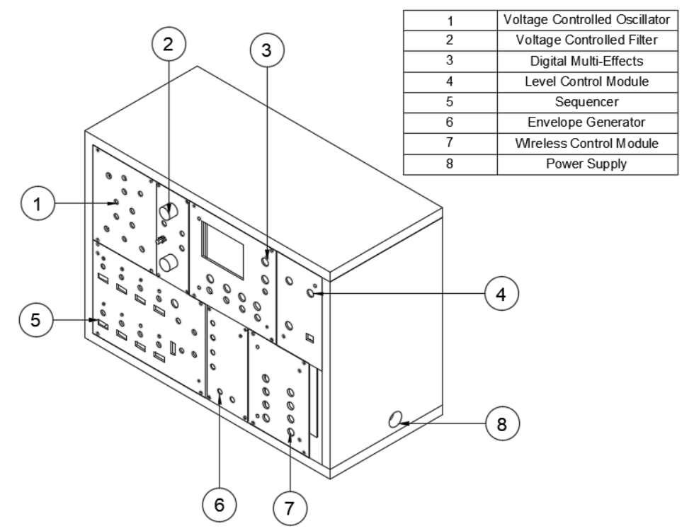



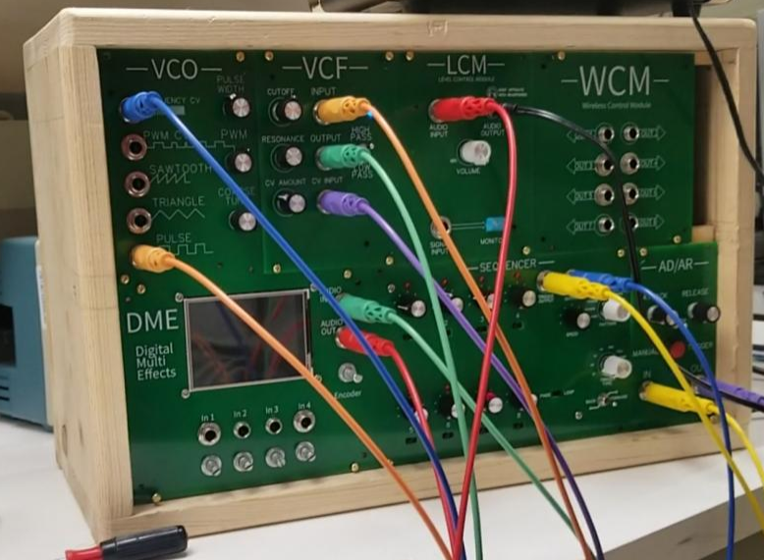
Modular Synthesis as an Educational Tool
Rafael Alvarez, Keri Grevemberg, Taylor LeBlanc, Tarik Lopez, Kyle Sellers
Objective Statement
System Diagram
Engineering Specifications
Design a subtractive modular synthesizer that can function as an instrument for musicians, and a teaching aid for electrical engineering students
Name | Specified | Actual
Bandwidth | 20 to 22kHz | < 10 to 33kHz
Power Consumption | 2.5 W | 14 W
Operating Temperature | < 80 C
Latency Wireless Control | < 100 ms | < 50 ms
Range Wireless Control | > 10 ft | > 50 ft
Instructional Material | 6 labs | 6 labs
Degree of Loudness | < 90 dB | 93 dB
Weight | < 20 lbs | 12.6 lbs
Background
In the classroom, Electrical Engineering Students lack real-world applications for major points in the curriculum. Subtractive modular synthesis can serve as a teaching aid for Electronics, Signals, and DSP.
Educational Value
Electronics
Op-Amp Configurations
Signals & Systems
Fundamental Frequency
Harmonics
DSP
Programming DSP
Sample Rate & Bit Depth
Lab Manuals
Assembled System
Budget
Total: $510.05
Electronics Signals & Systems DSP
Safety
Heat
Convection cooling via case vents
Heat sinks on power regulator
Loudness
Level Control Module
Output to Output Connections
Output buffers on every circuit
September
November
October
December
January
February
March
April
Determine functions & Constraints
Generate Concepts for Functions
Research Existing Implementations
Design Circuits
Analyze Circuits
Semester 1 Final Report & Presentation
Code Microcontrollers
Order Parts & PCBs
Research Educational Material
Parts & PCBs Arrive
Breadboard Testing
PCB Testing & Redesign
Order 2nd round PCB
Case Design & Manufacturing
Assemble Final System
Integration Testing
Finalize Mock Labs
Sponsors: Taylor LeBlanc, Kyle Sellers
Advisor: Dr. Jin-Woo Choi

